Slide 1
Satellite Symposium
Sunday 21st July
Drug Interactions in HIV Care

Slide 2
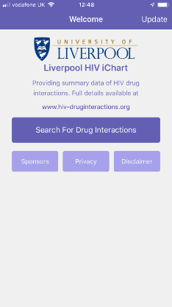
Organized by the University of Liverpool, UK.
Drug Interactions website www.hiv-druginteractions.org

Slide 3
Comprehensive
We aim for a comprehensive resource, complete with all HIV drugs and an exhaustive list of prescribed co-meds.
Content is constantly reviewed and updated with new data from major HIV meetings and literature sources.
DDIs are assessed using transparent methodology with scientific, clinical and editorial rigour. We use an adapted GRADE system of assessing evidence.
Dependent on multiple sources of funding
Up-to-date
Evidence-based
Freely available

Slide 4
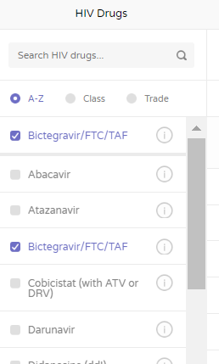
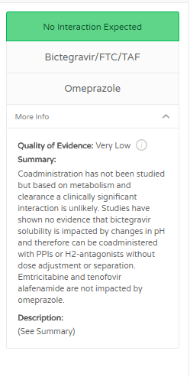
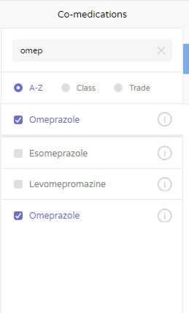
Clinically Useful:
1. Select HIV Drugs
2. Select Comedications
3. View DDI recommendations
Search by generic name, drug class or trade name
Click for further info

Slide 5
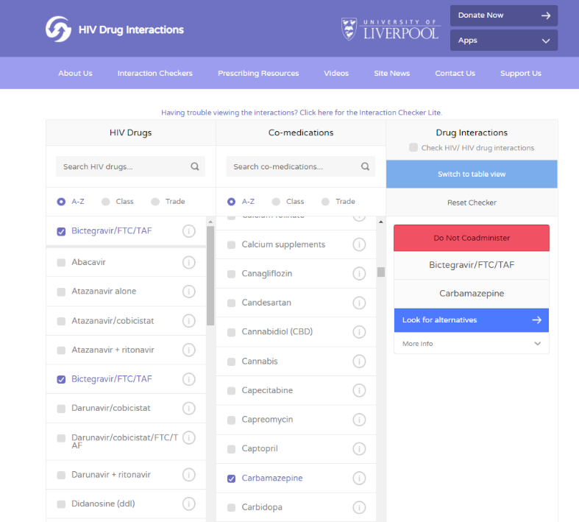

Slide 6
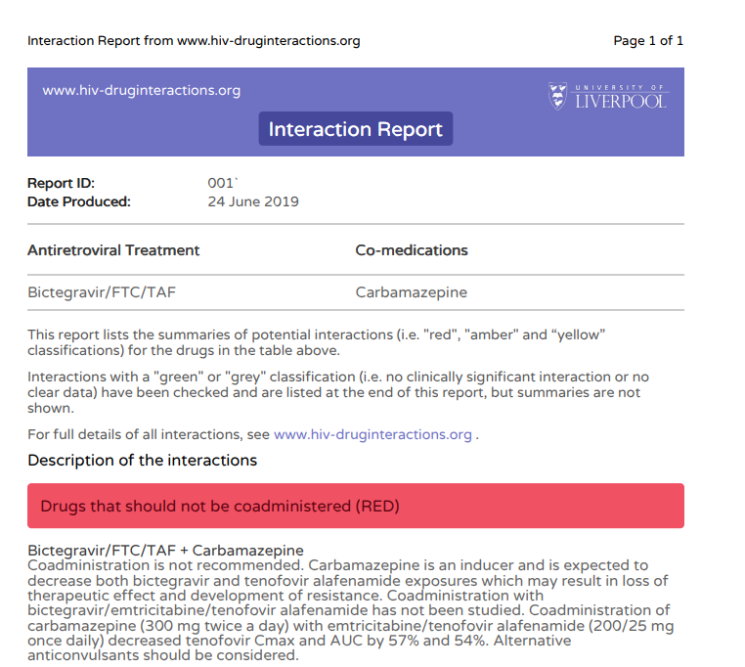
PDF interaction reports can be downloaded and saved to patient records

Slide 7
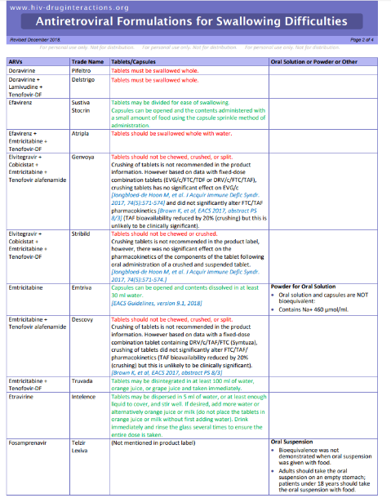
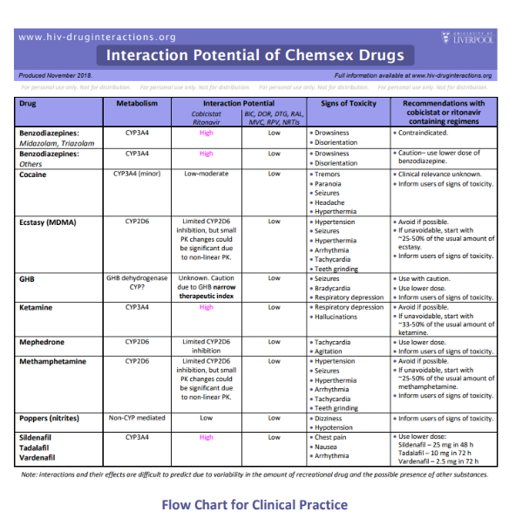
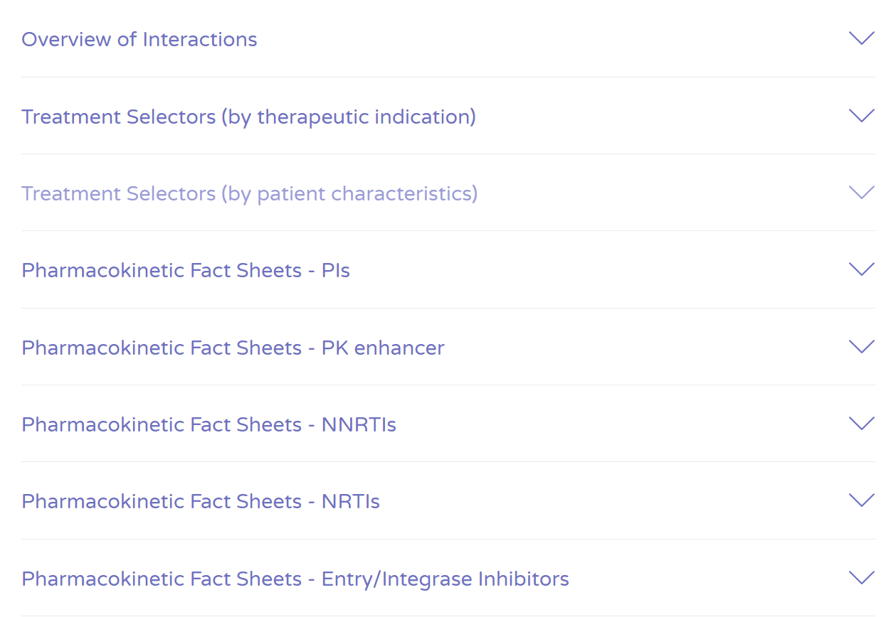
Over 50 printable charts and factsheets to support prescribing.

Slide 8
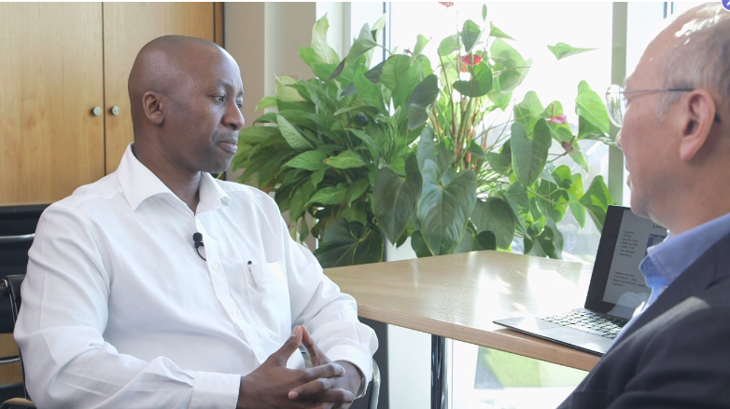
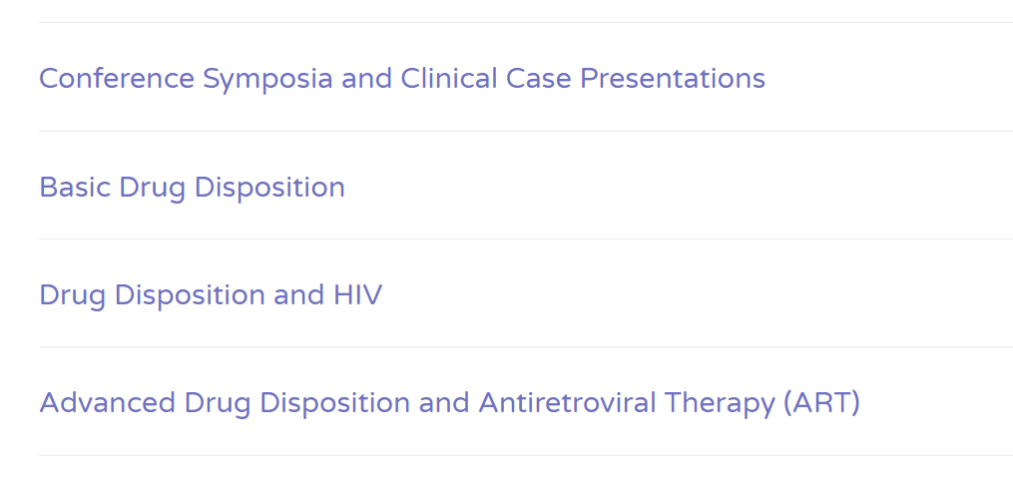
Over 20 mini-lectures on DDIs from world-renowned Clinicians, Pharmacists and Pharmacologists

Slide 9
Our User Base and Global Reach:
Each month……
28.5k unique users…
from 180 countries
search for approx 330,000 interactions on the HIV DDI checkers

Slide 10
2018 Usage data
Over 4 million DDI searches
performed across the website and app in 2018
App 24%
Website 76%

Slide 11
Global Reach
 | 2017 sessions | 2018 sessions | YOY increase
Chile | 1,804 | 4,583 | 154%
Taiwan | 1,215 | 2,490 | 105%
Colombia | 4,739 | 8,781 | 85%
Russia | 3,566 | 6,099 | 71%
Mexico | 5,732 | 9,531 | 66%
Turkey | 4,445 | 6,756 | 52%
Austria | 1,745 | 2,527 | 45%
Argentina | 4,456 | 6,367 | 43%
Portugal | 5,616 | 7,993 | 42%
Brazil | 9,010 | 12,804 | 42%
South Africa | 2,116 | 2,908 | 37%
France | 10,722 | 14,316 | 34%
Year-on Year Increase by Country 2017-18

Slide 12
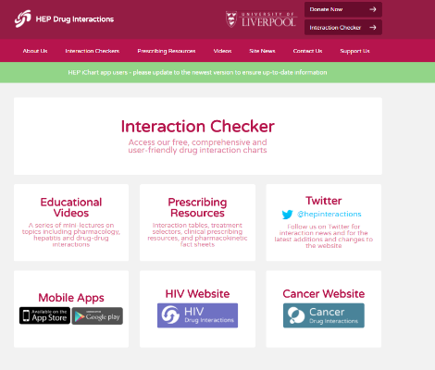
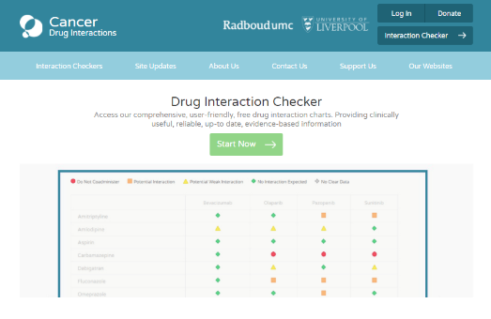

Slide 13
Translations
Spanish, Portuguese.
Russian, Chinese

Slide 14
Chairs: David Back, Liverpool, UK & Mauro Schechter Rio de Janeiro, Brazil
14.45-14.55: Welcome and Introduction David Back, Molecular and Clinical Pharmacology, University of Liverpool, Liverpool, UK
14.55 – 15.15: Mini-Lecture. Antiretroviral therapy in elderly individuals living with HIV Catia Marzolini, Basle. Switzerland.
Interactive Case-based Discussion.
15.15 – 15.45: Antiretroviral therapy and TB co-infection Ethel Weld, Baltimore, USA
15.45 – 16.15: Antiretroviral Therapy in Transgender Women Omar Sued, Buenos Aires, Argentina.
16.15-16.45: Antiretroviral Therapy and Women’s Health.
Claudia Cortes, Santiago, Chile.

